Slide 1
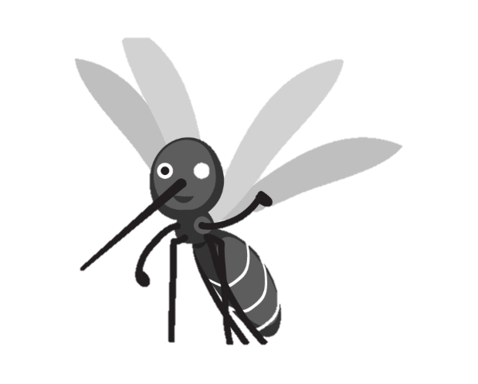
Using Weather Data to Predict Mosquito Count
Vrushang Patel – Graduate Student at University of Winnipeg
Jay Patel – Programmer Analyst at Pollard Banknote
Nico Cai – Educational Assistant at Red River College
Harshil Pethani – Network Administrator at Northland
Selina Chi – Data Scientist at Manitoba Agriculture and Resource Development

Slide 2
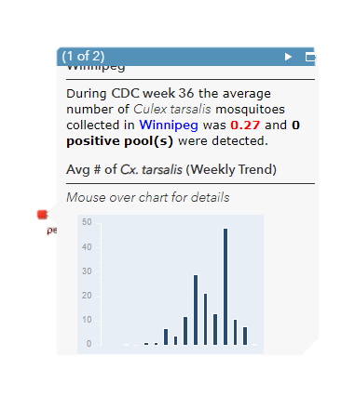
Problem/Challenges
Mosquitoes infected with the West Nile virus have been found in Manitoba. As there are currently no vaccines or treatments against WNV, the best way to prevent a WNV infection is to prevent mosquito bites. Despite ongoing surveillance of WNV in Canada, it continues to be a challenge for predicting disease spread.

Slide 3
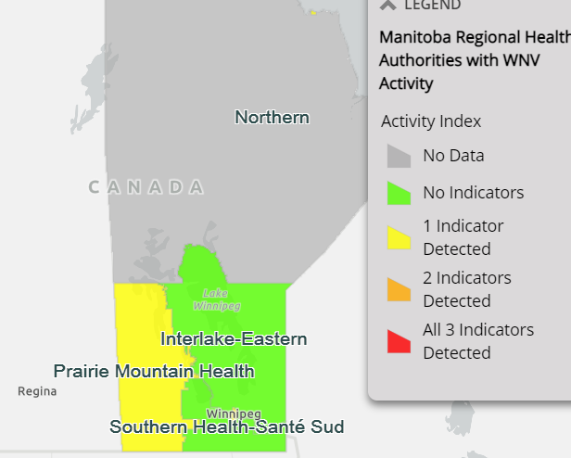
Problem/Challenges

Slide 4


Data Source
City of Winnipeg Open Data: Daily Adult Mosquito Trap
Count Date
Average Daily Mosquito Count
Daily Weather Data from Government of Canada: https://climate.weather.gc.ca/
Temperature (Max and Min, average)
Total Precipitation

Slide 5

Data that’s nice to have
Future Weather Forecast Data that can be exported as a flatfile for predictive analysis

Slide 6

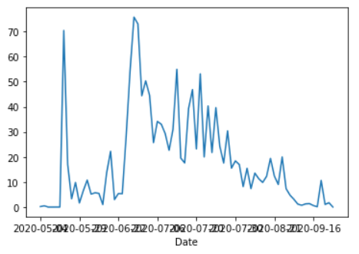
Our Predicted numbers

Slide 7
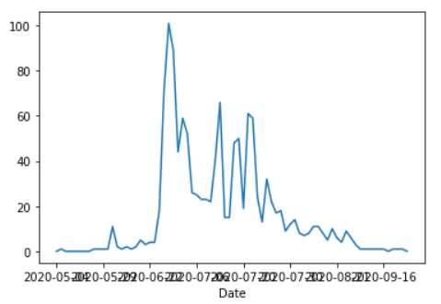
Original Numbers

Slide 8

How Will Your Solution Benefit the Citizens of Winnipeg?
Human WNV is strongly associated with the abundance of mosquitoes. By incorporating weather information we can help to predict seasonal trends and provide timely information for the citizens of Winnipeg
Geospatial information could be incorporated in the future to help predict areas with high risk of WNV infection

Slide 9


Thank you so much

